Slide 1
SE CONCEPTS Investigation on SDLC in a software house.
Presented by:
Muhammad Mujtaba
Malaika Wahid
Ayesha Majeed
Moeez-ur-Rehman

Slide 2
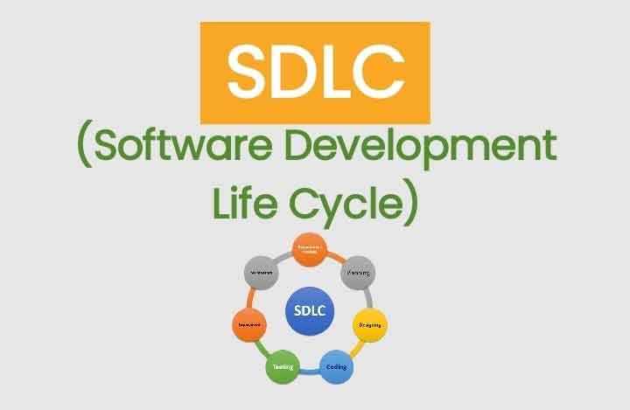
INTRODUCTION:

Slide 3

SOFTWARE HOUSE:
Infinity Bits helps enterprises digitally transform into competitive business entities.
They mark their expertise in the Software Design & Development, Digital Marketing, AI & Computer Vision etc.
Ongoing projects

Slide 4
THEIR METHODOLOGY:
They prefer agile development method.
What is agile methodology?
Flexible approach
Also varies from project to project.
They go for Hybrid approach as well.
In agile method, they use scrum model.

Slide 5
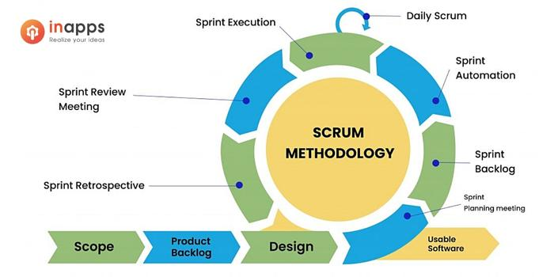
WHAT IS SCRUM MODEL?

Slide 6
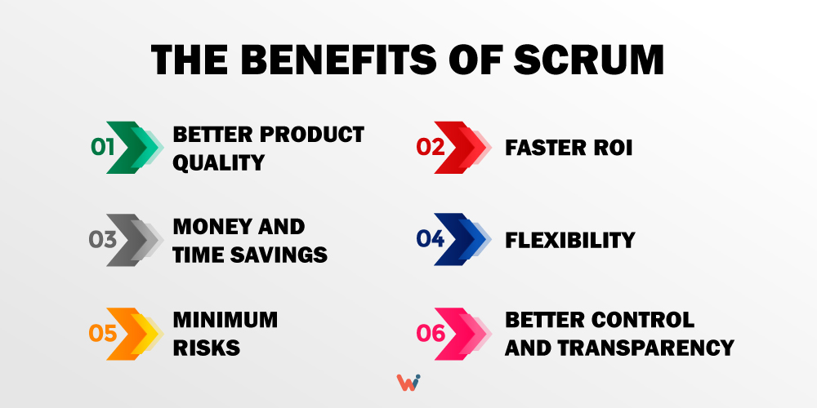
ADVANTAGES OF SCRUM MODEL:
Scrum helps teams complete their deliverables quickly and efficiently.
Encourages stakeholder involvement.
Flexible to changes
Large projects are divided into sprints.
Works well for fast-moving development projects.

Slide 7
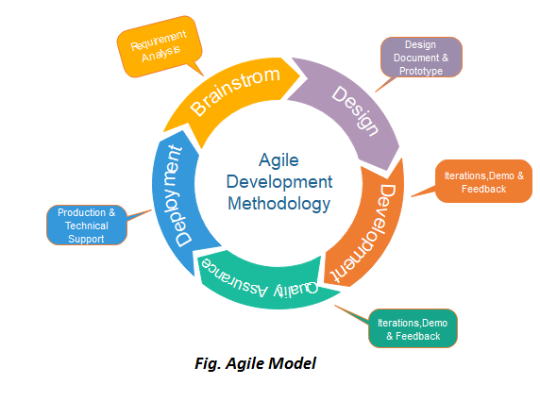
OUR FINDINGS:
1) THEY PREFER AGILE METHOD BECAUSE:
More features in a shorter time
Teams can quickly adapt to requirements changes without negatively impacting release dates.
Gives more flexibility
higher client satisfaction.

Slide 8
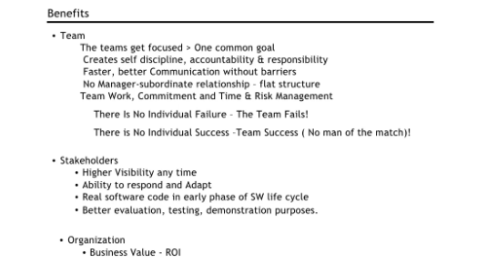
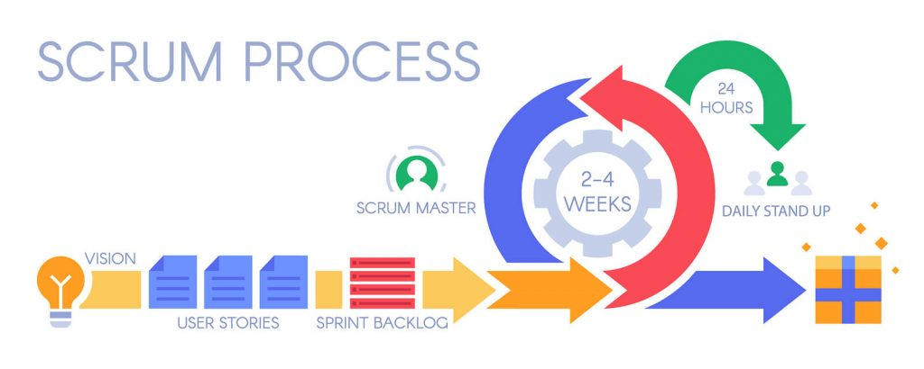
2) SCRUM METHOD:
They use scrum for their project visibility and transparency.
Visibility provides transparency into the development process. It is the ability to see progress at any point d
Determine the distance to completion of a goal.

Slide 9
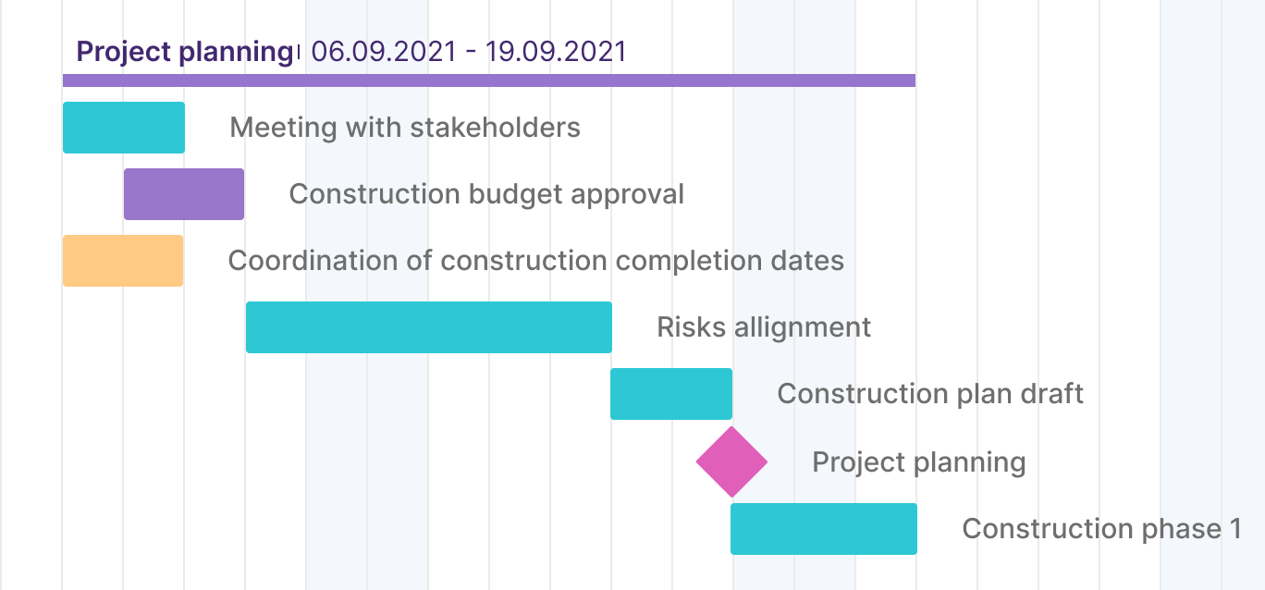
89,526,124$
3) SETTING MILESTONES:
They set milestones before starting any project.
It helps managers keep track of the schedule, deadlines
Management can also maintain a more accurate understanding of how the project is advancing.
EXAMPLE OF MILESONE

Slide 10
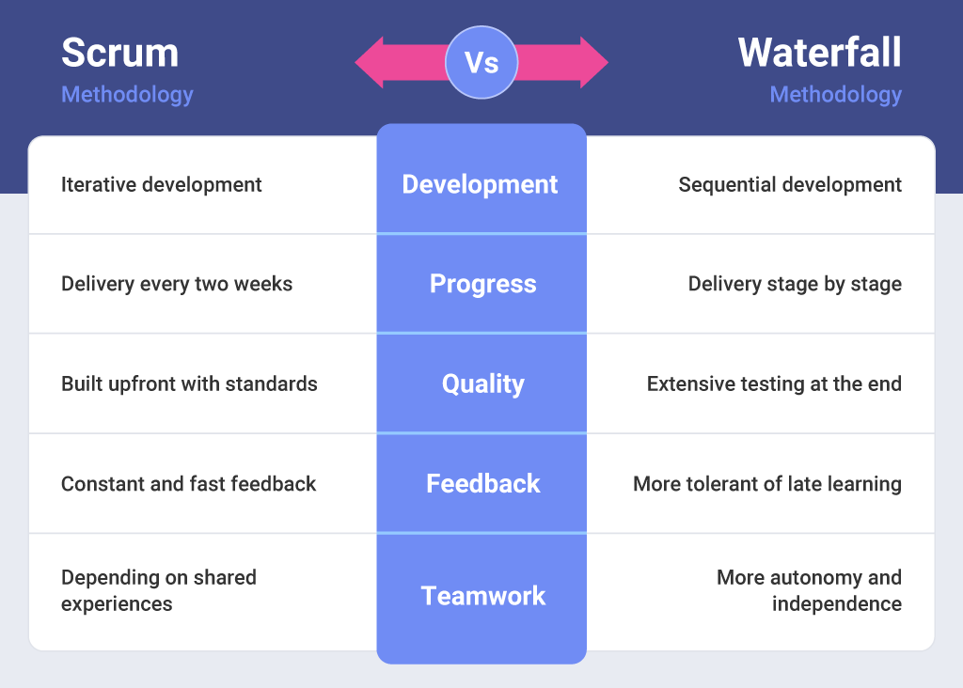
4) WATERFALL MODEL:
For the bigger projects, they go for waterfall.
The phases of the waterfall model are straightforward, anyone in the team can easily understand the whole development process.
Great for large, long-term projects.
Because of its rigidity, this methodology can be applied even with large projects.

Slide 11

5) MEETINGS WITH CLIENTS:
They hold meetings with clients after every spirit
This allows the product-development team to discuss what's working, what's not working, and how to improve things.

Slide 12
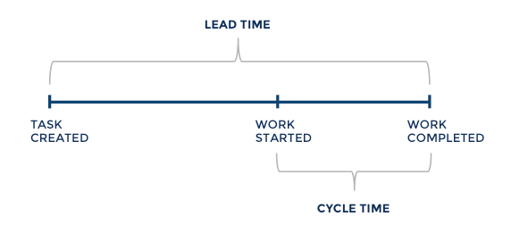
6) AVERAGE TIME:
They set the requirements during the meetings with the client and further discussions are made for another spirit cycle.
Their average delivery time is 4-5 weeks but vary in case of bigger projects i.e.: 2-3 months.

Slide 13
COMPARISON WITH OUR ACADEMIA:
By comparing industry practices with academia, we see that:
Agile method is carried out by juniors as well, unlike we studied.
Client is involved in feedbacks only, not whole process.
Use of any method entirely depends on circumstances.
And many small differences.

Slide 14
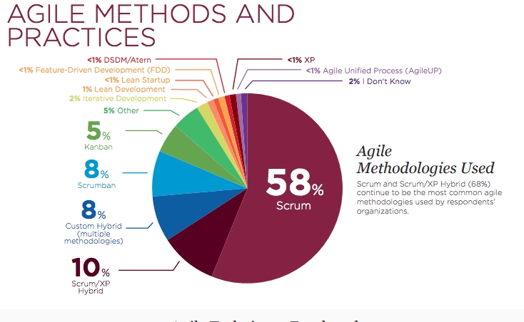
CONCLUSION:
Agile method is most commonly used. More than 50% of companies use it.
Choice of SDLC models depends on type of project.
Scrum method is suited for small projects.

Slide 15
THANK YOU

